Slide 1
PCORI Fees, Broker Compensation Disclosure, OBBB June 18, 2025
Presented by: Misty Baker, Director of Compliance & Government Affairs
Carol Taylor, Compliance Specialist

Slide 2
Disclaimer
The information herein should not be construed as legal or tax advice in any way. Regulations, guidance and legal opinions continue to change. The preparer has gathered public information and has attempted to present it in an easily readable and understandable format. Situations vary, technical corrections and future guidance may vary from what is discussed in the presentation.
This is meant for informational content only. The presenter makes no warranty of any kind concerning this information. You should seek the advice of your attorney or tax consultant for additional or specific information.
This presentation is not to be duplicated or distributed.
©2025 Centerstone Insurance and Financial Services, LLC d/b/a CRC Benefits. California License No. 0639679. No claim to any government works or material copyrighted by third parties. This material is intended for licensed insurance agency use only. This is not intended for business owner or insured use. If you are not a licensed agent, please disregard this communication.
2

Slide 3
Discussion Topics
CRC Group/CRC Benefits
PCORI Fees
Broker Compensation
One Big Beautiful Bill
3

Slide 4


Tiffany Stiller
Senior Vice President
Carrier Relations, Compliance, and Individual & Senior Division
4

Slide 5


Slide 6
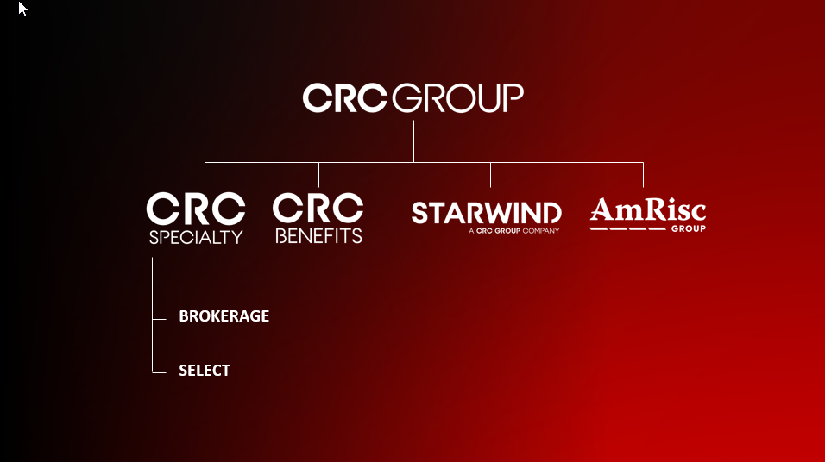

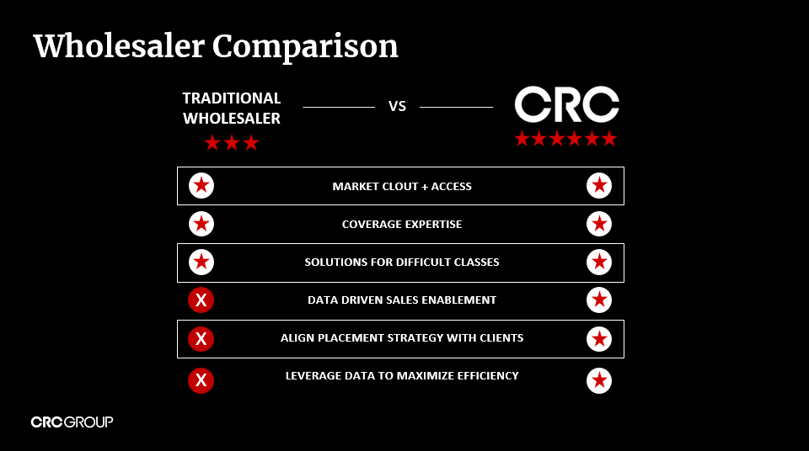

Slide 8
PCORI Fees: Explained

Slide 9
PCORI Fees Due July 31 each year (through 2029)
For plan years ending between January 1, 2024 and September 30, 2024, the applicable dollar amount is $3.22.
For plan years ending on or after October 1, 2024, through December 31, 2024, the applicable fee is $3.47 per covered life.
PCORI Fees
Applies to self-funded plans, including Health Reimbursement Accounts (HRAs) offered in conjunction with fully insured or self-funded plans.
(Some administrators may also refer to these as a MERP or Medical Expense Reimbursement Plan.)
ERISA Violations Can Be Costly
Penalties
Corrective Actions
Civil Litigation and Criminal Prosecutions
Revised Form 720 is NOW available!
https://www.irs.gov/pub/irs-pdf/f720.pdf

Slide 10
There are several methods to calculating PCORI fees:
Snapshot Method
At least one date during each month or each quarter. Dates in each quarter must be within three days of the dates for corresponding quarters. More than one date per month may be used, but the number of dates sampled from each quarter must be the same for all quarters.
Snapshot actual method
The total number of lives covered (employees and their covered family members or only employees if HRA or FSA) on each selected date, divided by the number of dates used.
Snapshot factor method
Instead of counting the number of lives, the lives may be calculated as the number of participants with self-only coverage plus 2.35 times the number of participants with other than self-only coverage. (Do not use this method for HRA or FSA plans.
Form 5500 Method
Can only be used with timely filed Form 5500s (no extensions)
Plan with only self-only coverage
Add the total number of participants at the beginning to the active participants at the end of the plan year, as reported on the Form 5500 for that plan for that year and divide by 2 to get the average for the year.
Plan with self-only and other than self-only coverage
Use the sum of the total number of participants (employees only) at the beginning and the end of the plan year, as reported on the Form 5500 for that plan for that year. The sum of the starting and ending number of participating employees approximates the total number of lives covered based on the theory that families with more than two covered lives will average out with those who have self-only coverage. (Do not use this method for HRA or FSA plans.)
Actual Count Method
Total number of lives covered (employees and their covered family members or only employees if HRA or FSA) on each day of the plan year, divided by the total number of days in the plan year.

Slide 11
If the Employer sponsors an HRA:
HRA and insured plan:
HRA and other self-insured plan:
Multiple HRAs and an insured plan:
Not treated as a single plan, so the employer/plan sponsor pays the fees for the HRA, and the carrier pays the fees for the insured plan. However, the employer/plan sponsor may count just employees as covered lives in the HRA and disregard covered dependents.
Treated as a single plan for purposes of calculating the fee, so each participant (including dependents) is only counted once.
The carrier still pays the fees for the insured plan. The HRAs may be treated as a single plan for purposes of calculating the fee, so each participant (disregarding covered dependents is only counted once.
11

Slide 12
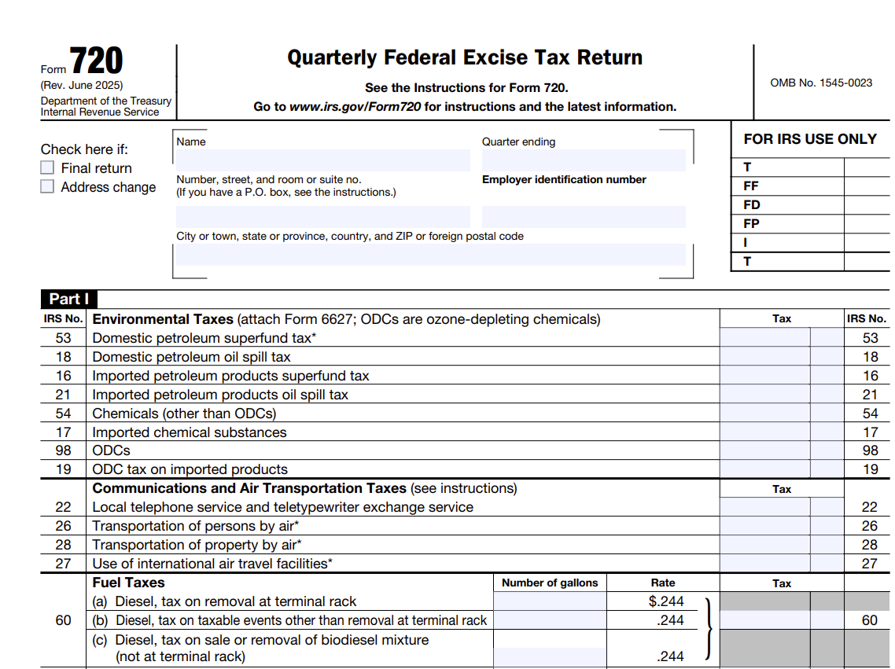
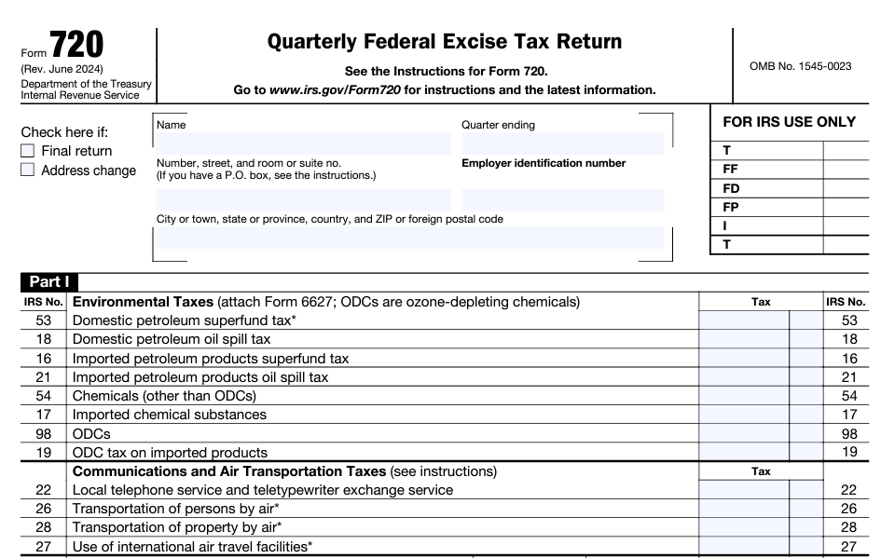
IRS Form 720
12

Slide 13
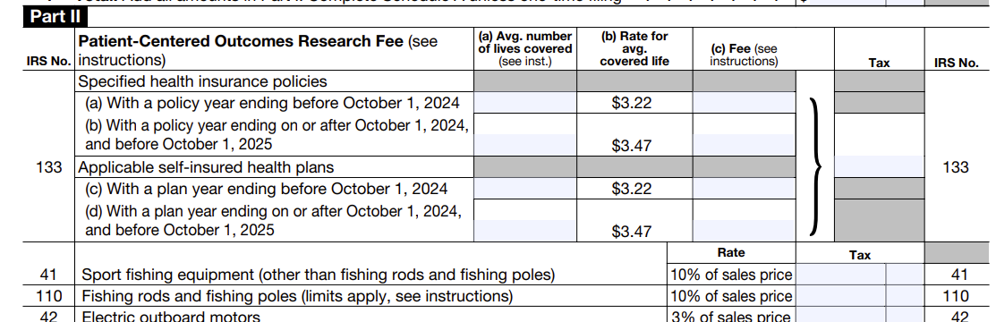
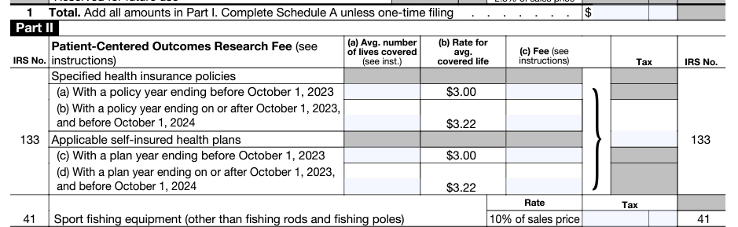
IRS Form 720
13

Slide 14
Broker Compensation Disclosure

Slide 15
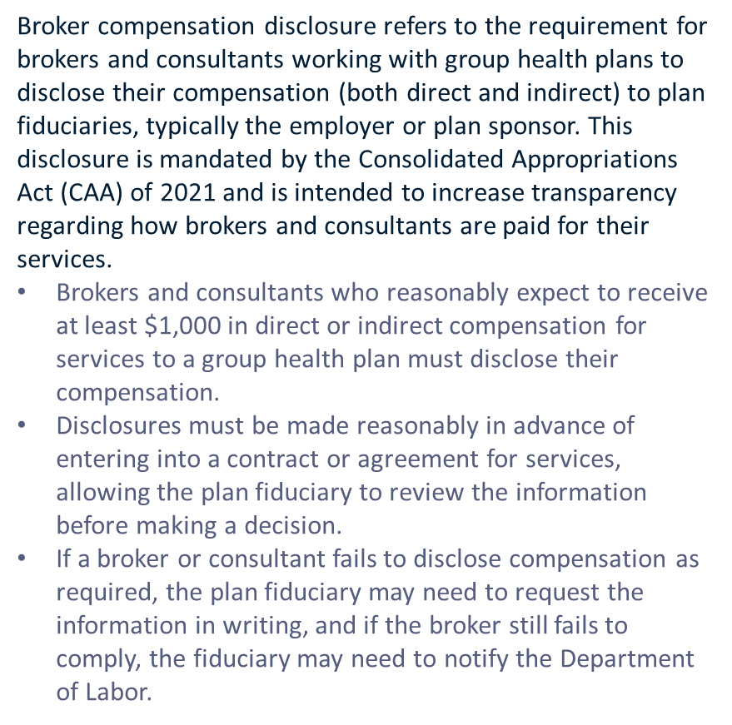
Broker Compensation Disclosure Form
15

Slide 16
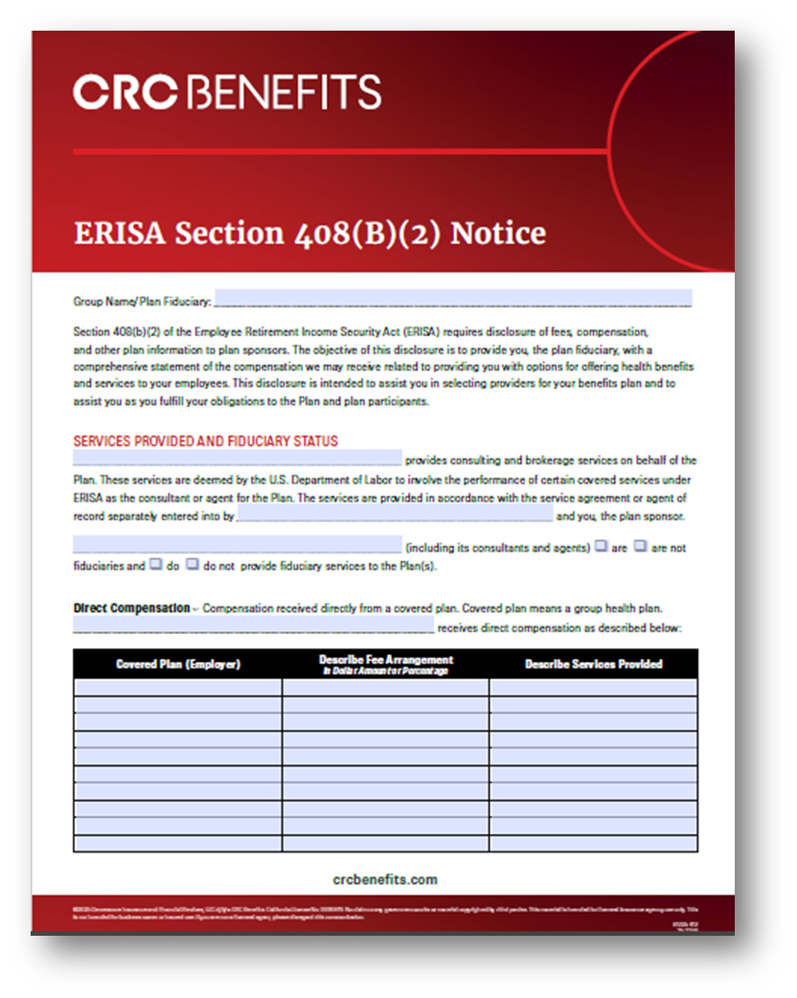
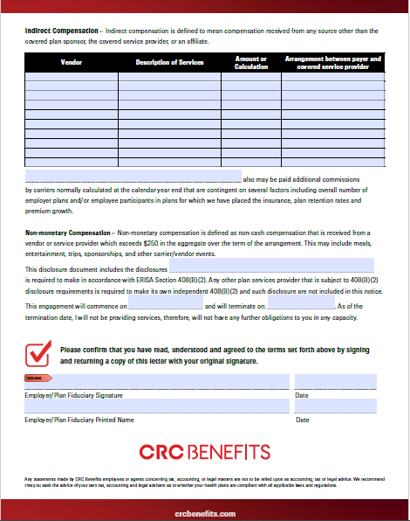
Broker Compensation Disclosure Form ERISA 408(b) Notice
16

Slide 17
What’s Up?
17
17

Slide 18

One Big Beautiful Bill- House Version
The proposed One Big Beautiful Bill Act, also referred to as OBBBA, OBBB, BBB or OB3, is a budget reconciliation bill in the 119th United States Congress.
OBBBA passed the House of Representatives on May 22, 2025 in a largely party-line vote of 215–214–1.
18

Slide 19

One Big Beautiful Bill- Senate Version
No HSA, HRA or CHOICE (ICHRA) mention in the Senate version
Some of the other health account provisions left out would increase the HSA contribution limit for low-income and moderate-income workers, let older workers contribute more to their HSAs, and let people use HSAs to pay for health club memberships and direct primary care program bills.
This Photo by Unknown Author is licensed under CC BY

Slide 20
Court Ruling Hamstrings IRS Enforcement of ACA Employer Mandate
On April 10, 2025, a federal court in Texas issued an opinion in the case of Faulk Co. v. Becerra that significantly impacts how the Affordable Care Act’s (ACA) employer mandate can be enforced.
The ruling effectively prevents the Internal Revenue Service (IRS) from assessing penalties against employers that fail to provide affordable, minimum health insurance coverage to their employees as required by the ACA for companies with at least 50 full-time equivalent employees.
The court ruled that before the IRS can assess penalties against employers for ACA violations, employers must first receive a notice/certification from the U.S. Department of Health and Human Services (HHS) through an ACA exchange. Crucially, the court determined that the IRS cannot issue this required notice instead of HHS.
This ruling invalidates a 2013 HHS regulation that had delegated this notification authority to the IRS. The court reasoned that HHS impermissibly transferred its responsibility to the IRS, and that only HHS and the ACA exchange can lawfully issue the required certification.
The case will likely have to continue its way through the appellate process. If the decision is affirmed on appeal, resolving this issue would require either:
HHS and the exchange implementing a system to notify employers of ACA violations, or
Congressional legislation amending the ACA to authorize the IRS to issue the required certifications.
Both options would face significant hurdles given the current political landscape, including the Trump Administration’s agency reform initiatives and Republican majorities in Congress.
20

Slide 21

AI in Health Insurance
Claim Processing
Prior Authorization
Actuarial Analysis
Member Experience
Predictive Analytics
Compliance
20

Slide 22

2026 Inflation-Adjusted Amounts
HDHP Minimum Annual Deductible
HDHP Maximum Out-of-Pocket Expense (in-network)
Maximum HSA Contribution
ACA Compliant Plans Out-of-Pocket Maximums
Single ̶̶ $1,700 Other than Self-Only ̶ $3,400
Self-Only ̶̶ $4,400 Other than Self-Only ̶ $8,750
Maximum catch-up contribution for those age 55 or older remains at $1,000
Self-Only ̶ $10,150 Other than Self-Only ̶ $20,000
Self-Only ̶̶ $8,500 Other than Self-Only ̶ $17,000
22

Slide 23
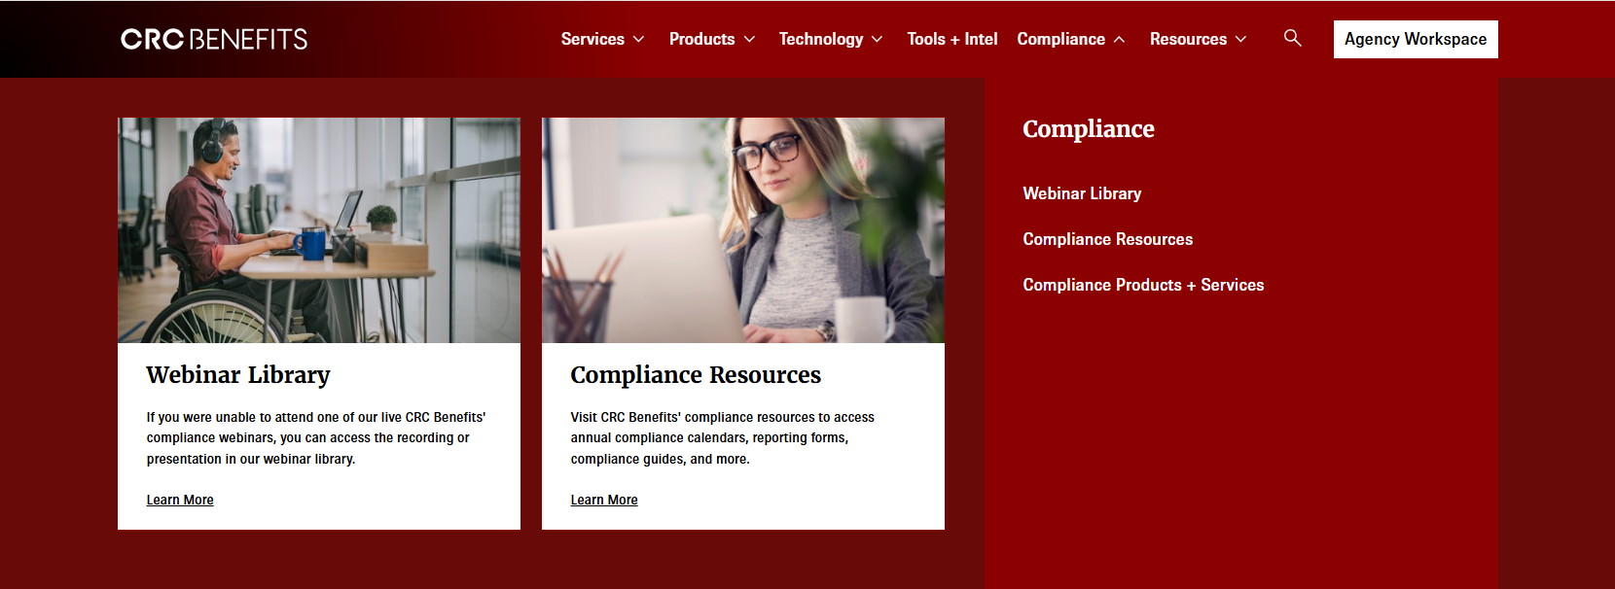
Have You Used Our Compliance Resources?
https://www.crcbenefits.com/compliance/
23
23

Slide 24
Questions for the Compliance Team?
crcbenefitscompliance@crcgroup.com
(compliance@benefitmall.com)
Misty Baker
misty.baker@crcgroup.com
Carol Taylor
carol.taylor@crcgroup.com
Thank you for attending today’s session!
24
24

